Slide 1
Project Proposal
Selam Tesfamariam

Slide 2
Research Statement
Review tweets made about specific insurance companies
Independent variable - Insurance Companies
Progressive
Geico
State Farm
Dependent variable - tweets
Frequency of tweets within a specific timeframe
Trends
Emotion
Notes:
Depending on this search - possibly add Texas Farm Bureau and USAA
Trends regarding commercials, customer service, and interactions with the company’s’ social media accounts.

Slide 3
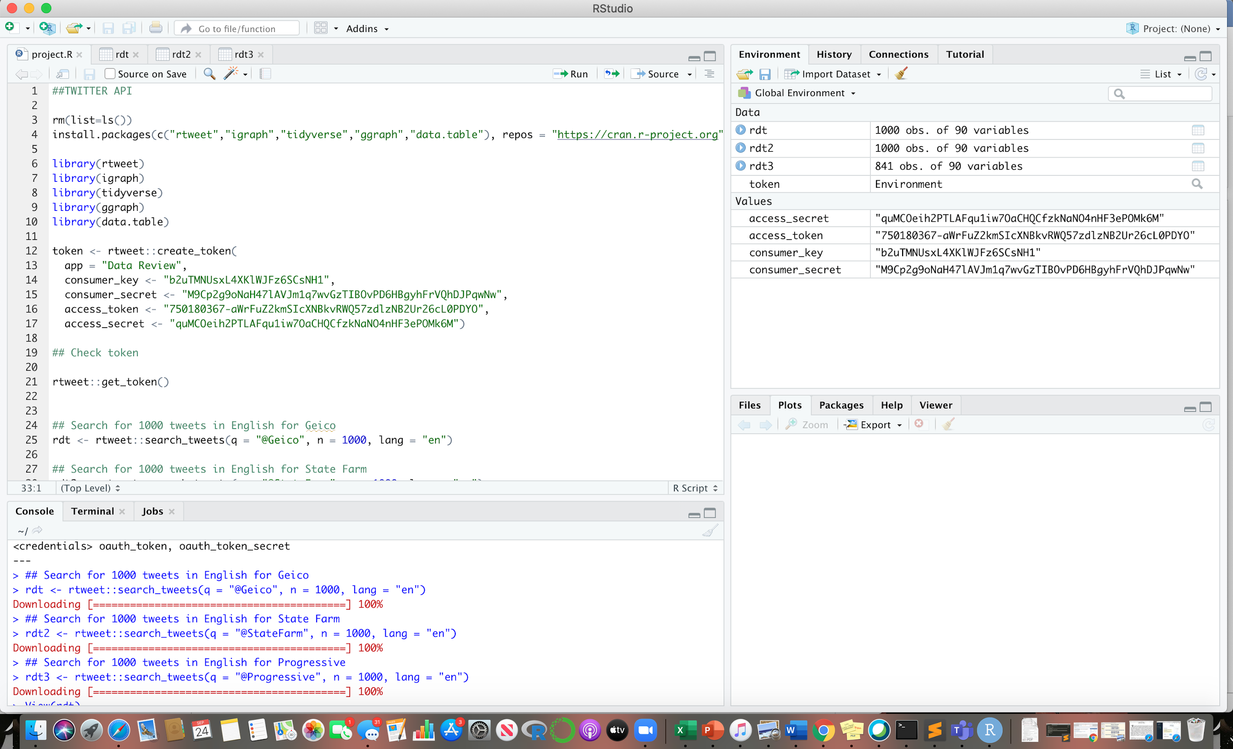
Data
Twitter API
Developers account
Consumer Keys
Rstudio

Slide 4
Visualization Method
R Studio
ggraph
tidyverse
rtweet
ggplot2
Python (maybe)

Slide 5
Layout
Time Series graph - to visualize trends in counts over time
Frequency graph
Sentiment Model
Notes:
Time series graph - visualize trends in counts over time

